Slide 1
Secure Settings – Select Options
AVCDL-Implementation-3.1.3
Charles Wilson
Staff Product Cybersecurity Architect
version 2
2025-09-29
Notes:
Script:
I'm Charles Wilson, staff product cybersecurity architect at Torc Robotics.
This presentation will cover the Secure Settings – Option Selection activity.

Slide 2
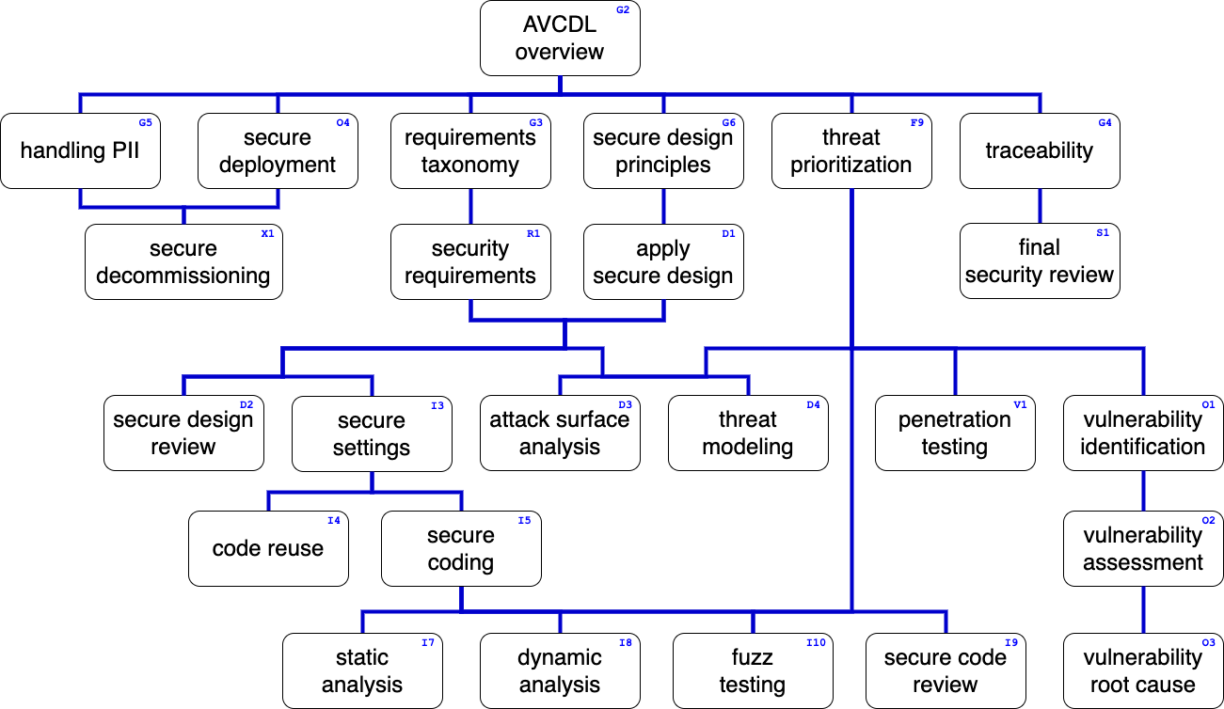
Training Path
Notes:
Script:
This diagram shows the overall AVCDL training path.
If you're taking this training, it's assumed that you've already completed the AVCDL Overview training,
and additionally, that you've completed the
Requirements Taxonomy
Security Requirements
Secure Design Principles
Apply Secure Design
Secure Settings Overview
Secure Settings – Identify Options
and
Secure Settings – Categorize Options
trainings.
This training will cover the Secure Settings – Option Selection activity.

Slide 3
Introduction
Notes:
Script:
Before getting into option selection, let's briefly review where it fits, in the overall secure settings process.

Slide 4
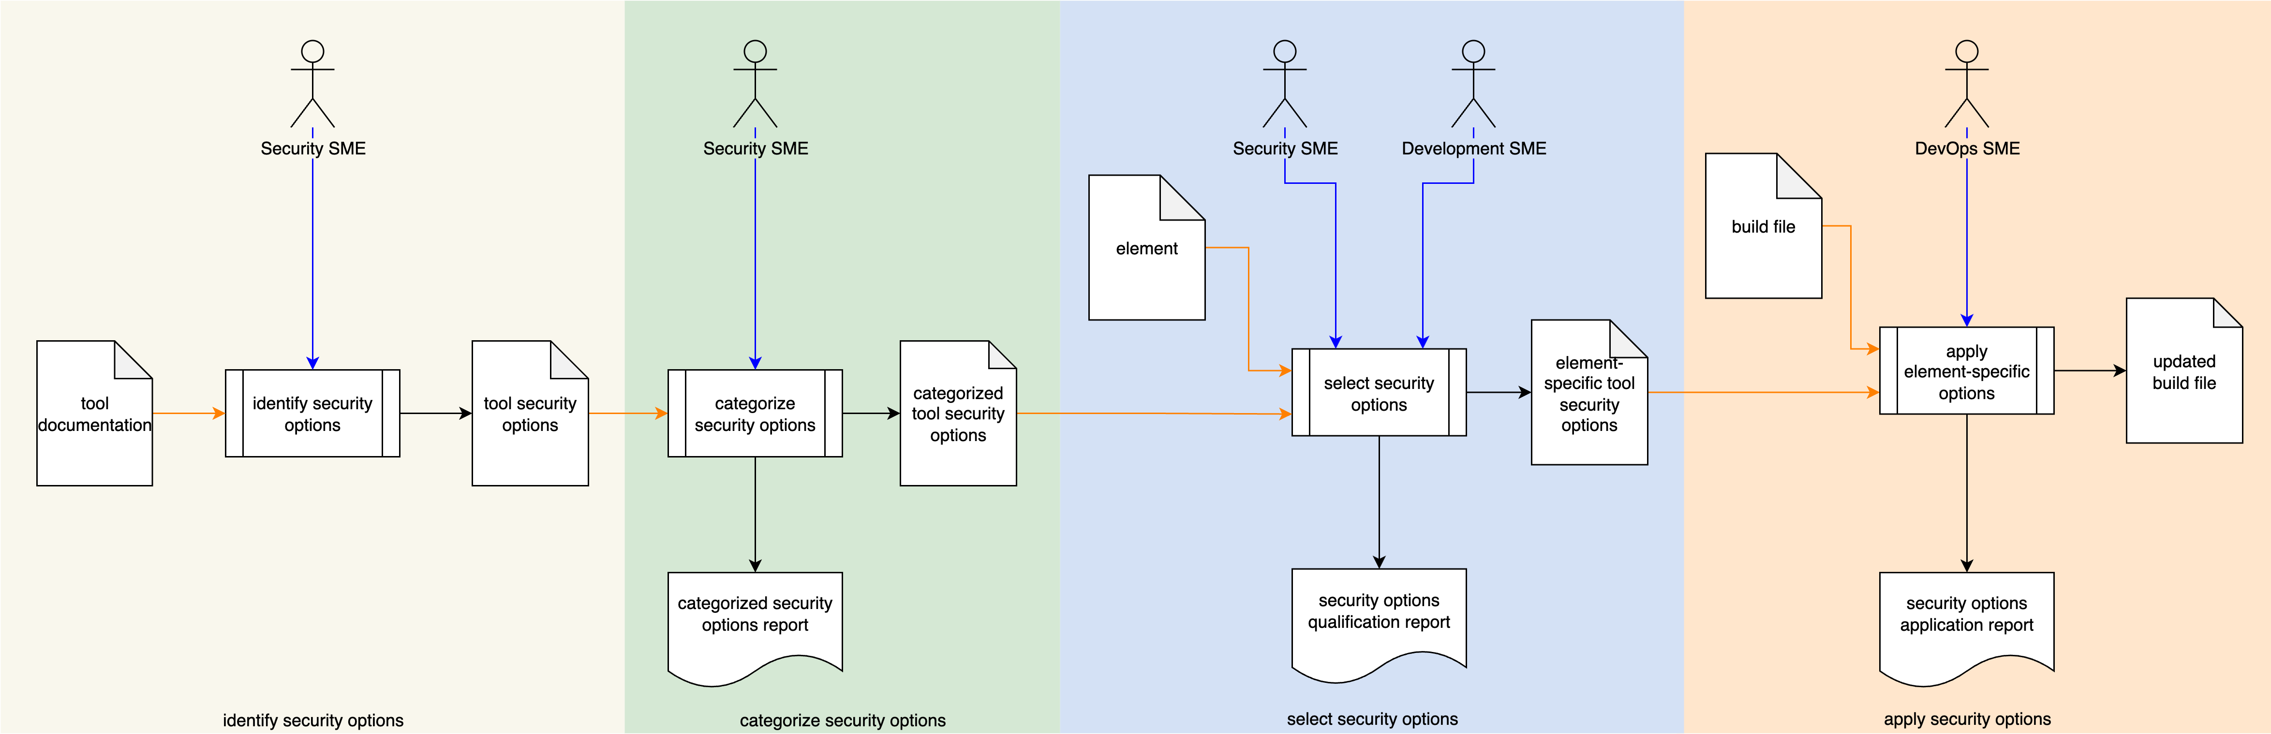
Secure Settings Process
Notes:
Script:
Here's the secure settings process which we previously covered in the Secure Settings Overview.
[break]
Our focus for this training is going to be on the third activity, that of option selection.

Slide 5
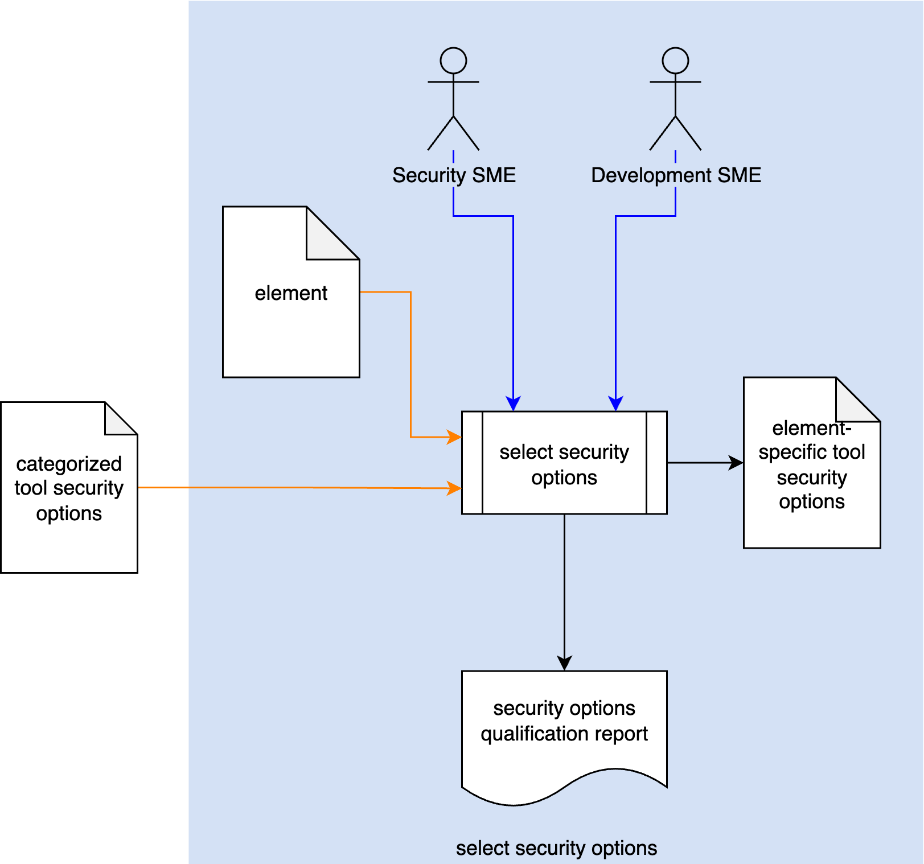
Secure Settings Process
Notes:
Script:
Here's the secure settings process which we previously covered in the Secure Settings Overview.
[break]
Our focus for this training is going to be on the third activity, that of option selection.

Slide 6
Select Options Activity
Notes:
Script:
Within the option selection activity,
The security SME and the development SME
[pause]
take
[pause]
the categorized tool security options document from the option categorization activity,
[pause]
and the element documentation
[pause]
and select the security options appropriate to the element,
[pause]
creating an element-specific tool security options document
[pause]
and generating a security options qualification report.

Slide 7
Example
Notes:
Script:
Now let's work our way through an example of selecting the tool’s cybersecurity-relevant options appropriate to a specific element.
We'll be using the categorized tool security options document created in option categorization activity as input and
applying the AVCDL element-specific tool cybersecurity options template which is described in the tertiary document that goes along with this training.
It's important to note here that this is just one mechanism for documenting this information.
There are any number of ways this information could be documented.
In an ideal world, you'd use a database to store this information.
Introducing the cybersecurity-relevant options to the element-level greatly increases the number of variants which need to be tracked.

Slide 8
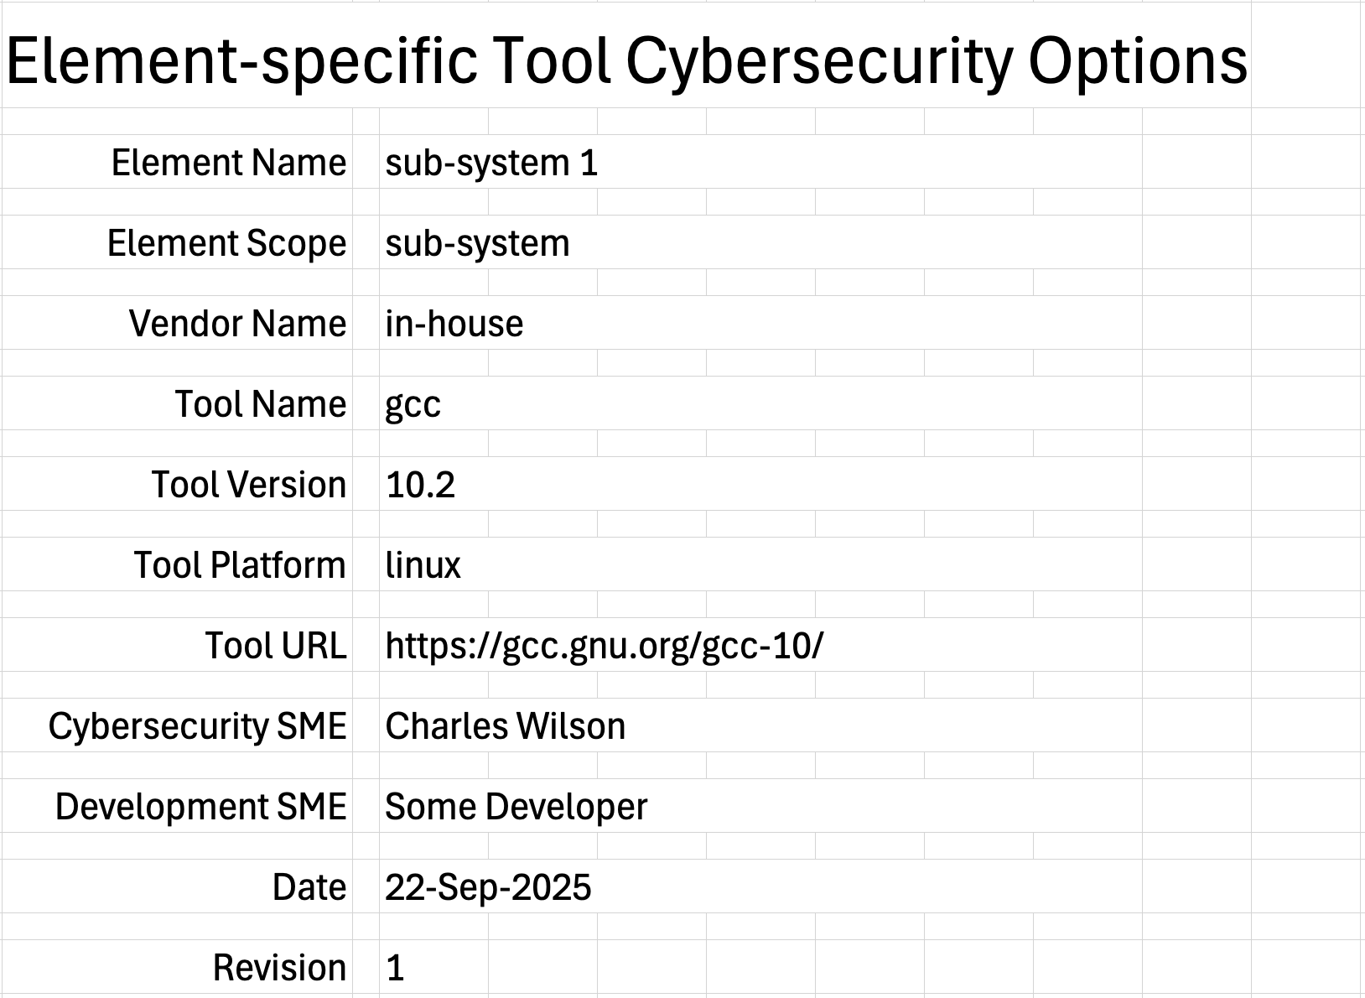
Cover Sheet
Notes:
Script:
We'll begin by taking information from the categorized tool security options document and populating our instantiation of the template for the example that we're going to use.
The tool name is GCC,
the version is 10.2,
the platform is Linux.
And here's the tool URL.
Now we'll provide the remainder of the information.
We have the element name,
the element scope,
the vendor name, and in this case, it was developed in-house.
We come down a bit to the cybersecurity engineer.
As a reminder, this may or may not be the same as in the categorization activity.
We also have the development SME.
As always, we have the date of modification
and the revision number.

Slide 9
References
Notes:
Script:
Our references are going to include the relevant references from the previous activities because, since we're involving the development SME, it's useful to have these as available if there’s an issue with a decision that's been made in this activity.
We'll directly reference the example tool cybersecurity options document, in this case, version 2 of that document, as shown here.

Slide 10
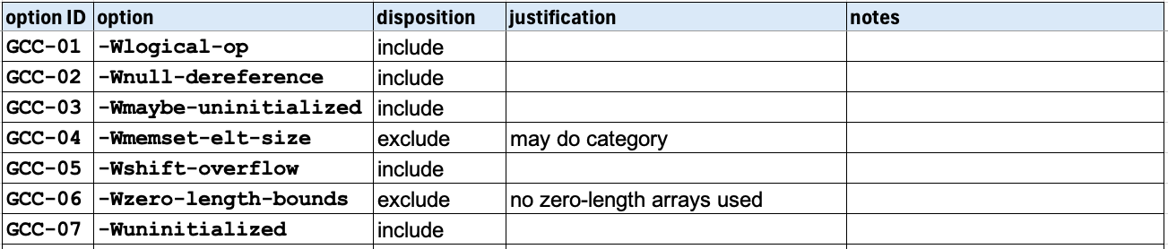
Options
Element source not modifiable
Option not applicable to the element
Option use consumes excessive time
Option is experimental
Notes:
Script:
For the options, we'll bring across the option ID and the option.
We can refer back to the other document if we need to get into more detail, but this is the only information that we need here.
For each of option, the development SME and the cybersecurity SME will discuss whether or not it should be included the build.
Where it's determined that an option will be excluded, a justification should be provided.
In this case, for GCC-04, we have that we're excluding it because it's in the “may do” category.
As discussed previously we're not going include options categorized as “may do.”
For GCC-06, we're excluding it because the check of zero-length bounds is considered to not be relevant to this element because it uses no zero-length arrays.
Here are some general reasons to exclude an option.
The element source is not modifiable, so we just can't take up the switch because it will, cause warnings which cannot be addressed.
[pause]
The option is not applicable to the element.
We see this here with GCC-06.
[pause]
The option might consume too much time for the build process.
This is something very tool specific and will be addressed in the specific tooling trainings.
[pause]
And finally, the option is experimental and so should not be used in production builds.
This is of concern to tools which are involved in code generation.

Slide 11
Report
Notes:
Script:
The final step is going to be the generation of the security options qualifications report.

Slide 12
Human-readable Report
Document of record
Tracks with element documentation
Notes:
Script:
So why again are we doing this human-readable report?
First, it's the document of record.
It’s the thing that shows why we made certain decisions.
In the cybersecurity realm, it doesn't matter what you do right.
What matters is that when you decide to not do something that’s cybersecurity-relevant, that you have an appropriate justification.
That justification needs to be documented and this report is that document of record.
It's going to be stored away so that if it's ever needed, we can review when the decision was made, who did it, and why.
[pause]
The second point is that this is material that needs to track with the rest of the element documentation.
And so, it needs to be filed so that when you look at the element in its totality, you can say, this is the history of this element, and this is why we made certain decisions about it.
If we need to change those decisions, we’ll have the pertinent information all in one place.

Slide 13
Recap
Notes:
Script:
With that, we've covered all the particulars of option selection.
And now let's look at a summary.

Slide 14
Summary
Involve the element’s development SME
Select element-appropriate tool options
Provide justification where appropriate
Create a human-readable report
Notes:
Script:
As we go through this activity, it's important to involve the elements development SME.
Remember that it's not the place of cybersecurity to be making decisions for development.
We present them with the information that shows what the cybersecurity options are, and what the rationale behind having each is and then development makes the final call as to which of these options they will put in place.
[pause]
We want to select the element-appropriate tool options.
So, again, we're going to work in conjunction with the development SME.
[pause]
We need to provide justification where it's appropriate.
When do you need to justify things?
When you're excluding them.
This is one of the reasons that we record the names of the development and cybersecurity SMEs.
[pause]
Finally, we want to create that human-readable report so that we have traceability.

Slide 15
Example Materials
<AVCDL>/source/reference_documents/working_material/secure settings/
Notes:
Script:
The materials that were used to cover this example are in the location shown here.
It's important to note that the workbook includes all the sheets covered in this training.

Slide 16
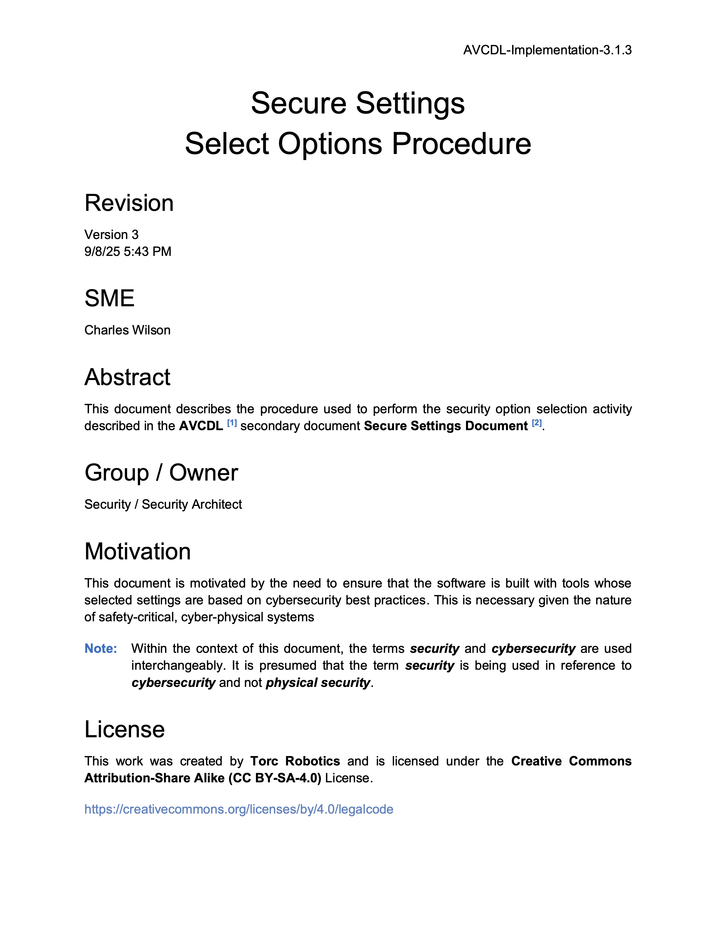
Further Reading
Notes:
Script:
For additional information and to get a more in-depth set of references, the Secure Settings – Select Options Procedure tertiary document is available in the AVCDL GitHub repository.

Slide 17
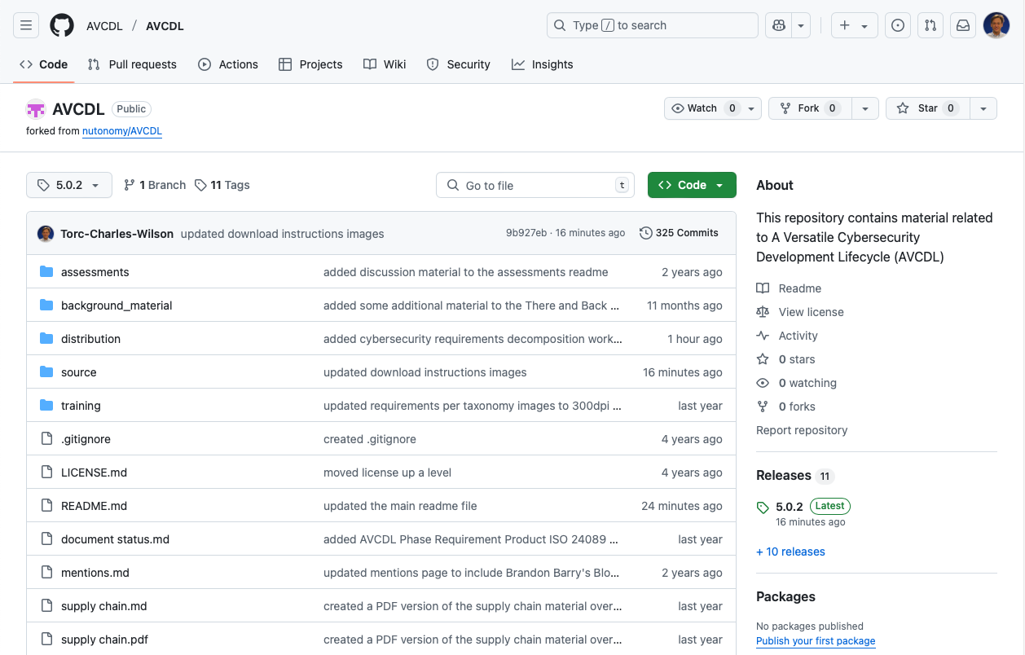
AVCDL on GitHub
https://github.com/AVCDL/AVCDL
Notes:
Script:
All AVCDL materials, both in source and distribution forms, are available on our GitHub site, as shown here.
Because of the size of the repository, it's recommended that you either clone the repository or download a ZIP archive of it, if you're not familiar with using git.
Instructions for downloading a ZIP archive are linked to on the repository’s front page.

Slide 18
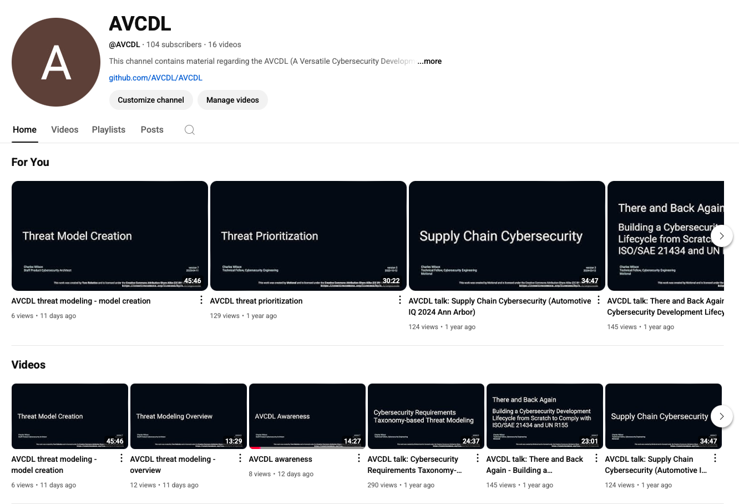
AVCDL on YouTube
https://youtube.com/@AVCDL
Notes:
Script:
Videos covering various aspects of the AVCDL are available on our YouTube channel, as shown here.
It's important to note that all AVCDL materials except for the introductory blog posts are intended for product cybersecurity engineering practitioners.

Slide 19
Next Steps
Notes:
Script:
With this training complete, if you’ve completed the other trainings covering the Secure Settings process activities, you can proceed to the other training at this level, Secure Design Review.
Additionally, if you’ve completed Threat Prioritization you can also proceed to
Attack Surface Analysis
Threat Modeling
Penetration Testing
and
Vulnerability Identification
Additionally, you can proceed to either
Code Reuse
or
Secure Coding

Slide 20
References
AVCDL primary document
Secure Settings Document (AVCDL secondary document)
Secure Settings – Identify Options Procedure (AVCDL tertiary document)
Secure Settings – Categorize Options Procedure (AVCDL tertiary document)
Secure Settings – Select Options Procedure (AVCDL tertiary document)
AVCDL element-specific tool cybersecurity options template (AVCDL template)
Notes:
Script:
Here are references to the source material used in the creation of this presentation.
They'll also be included in the video description.
Additionally, this presentation’s source material will be provided on the AVCDL GitHub repository.

